Slide 1
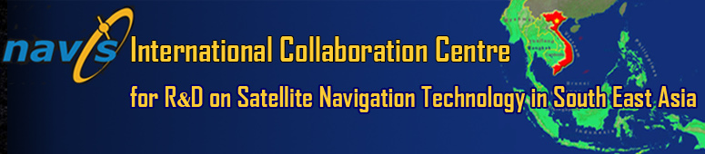

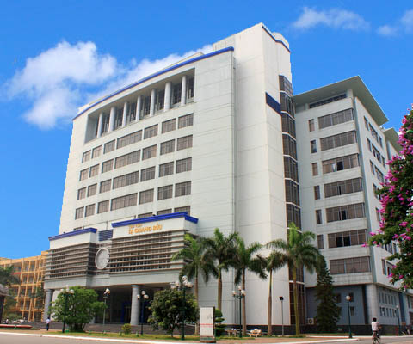







“The mission of Navis is to boost the R&D of satellite navigation technology, especially the European Galileo System, in South-East Asia.”
http://navis.hust.edu.vn

Slide 2
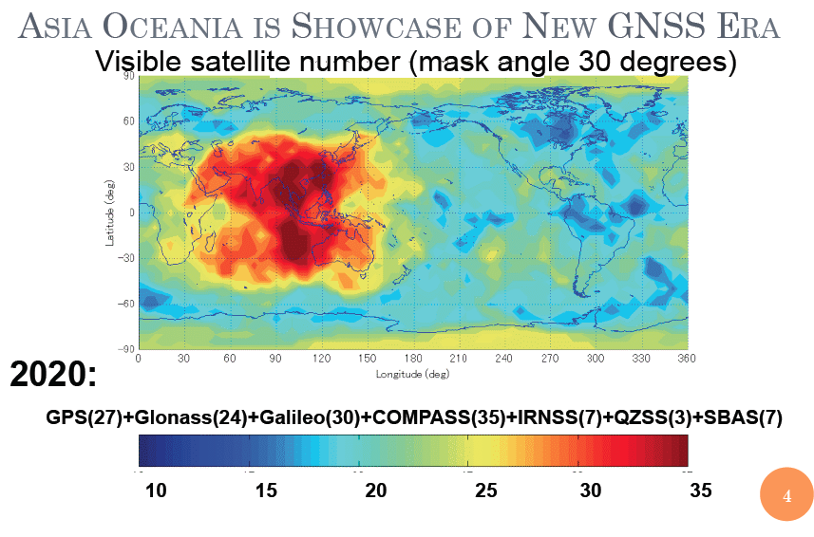
Multi-GNSS Environment in SEA region
The region:
10 countries
625 million people
Fast GDP growth
Vietnam
Big GNSS market:
Transport (ITS, traffic safety)
Environment monitoring (landslide, tsunami…)
Location based services
Satellite Navigation:
Access to almost the GNSS/RNSS systems
Do not own any GNSS/RNSS
Source: MGA

Slide 3
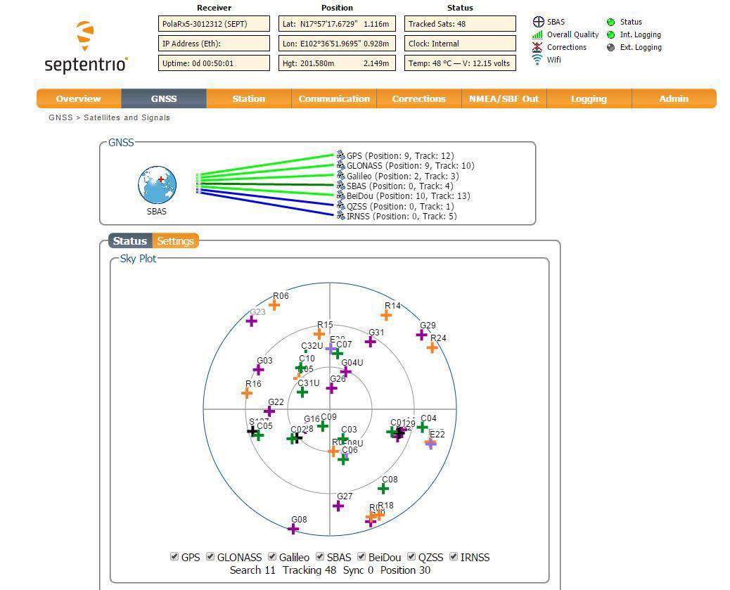
Image courtersy of Alain Suskind (Septentrio)

Slide 4
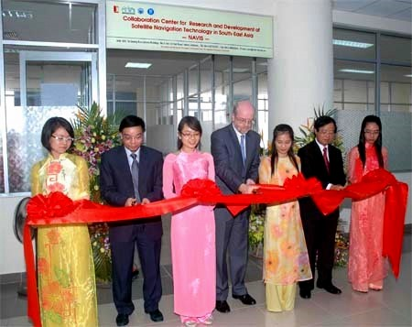
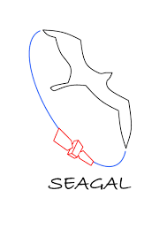


Milestones
2005 – 2007: JEAGAL (Joint European-Asian educational and application development programme on GALileo)
2009 – 2010: FP7 SEAGAL (South- East Asia centre on European GNSS for international cooperation And Local development)
October 1st, 2010: Navis Centre was inaugurated
2012 – 2015: FP7 Growing NAVIS
2015 – 2018: H2020 BELS (Building European Links toward SEA in the field of GNSS)

Slide 5
Centre Organization
Board of Supporting Institutions
Members: one representative for each Supporting Institution
Duties:
Proposes the International Co-Director and the members of the Scientific Committee
Revises the Annual Report providing comments and guidelines
Approves new possible Supporting Institutions
Executive Committee is constituted by the Vietnamese Director and the International Co-Director nominated by the President of HUST
Duties:
Manages and supervises the everyday life of the Centre
Prepares Annual Reports and plans
Scientific Committee is nominated by the President of HUST (currently the Committee includes 7 international prestigious experts in the field)
Duties:
Provides scientific advice and directions
Examines and approves the Scientific Report of NAVIS

Slide 6


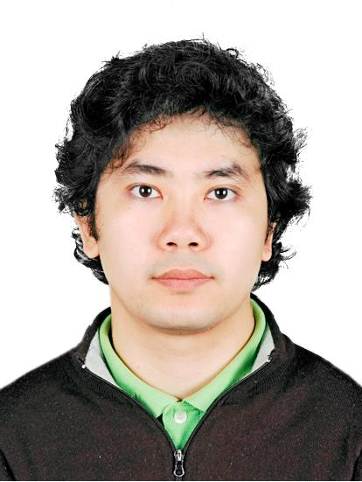

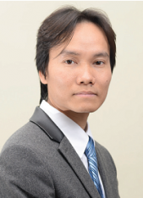
People
Board of Supporting Institutions:
Mrs. Gabriella Povero
ISMB - Italy
Dr. Jaume S. Subirana
UPC - Spain
Prof. TA Hai Tung
HUST - Vietnam
Prof. Gustavo Belforte
Polito - Italy
Executive Committee
Prof. TA Hai Tung
Director
Prof. Gustavo Belforte
International Co-director
Dr. La The Vinh
Vice-Director

Slide 7
Scientific Committee:
Name | Organization | Occupation | Country
1. Prof. Letizia Lo Presti (Chair) | Politecnico di Torino | Head of NavSAS group | Italia
2. Prof. Chris Rizos | University of New South Wales | - Head of School of Surveying and Geospatial Engineering - President of the International Association of Geodesy (2011-2015) | Australia
3. Prof. Doan Minh Chung | Space Technology Institute – Vietnam Academy of Science and Technology | Director | Vietnam
4. Prof. Jaume Sanz Subirana | Universitat Polytecnica de Catalunya | gAGE group | Spain
5. Dr. Bärbel Deisting, | bavAIRia e.V. |  | Germany
6. Prof. Huynh Quyet Thang | Hanoi University of Science and Technology | Dean of School of ICT | Vietnam
7. Prof. Vu Van Yem | Hanoi University of Science and Technology | Vice-Dean of School of Electronics and Telecommunication | Vietnam

Slide 8

Staff:
15 researchers (mostly got post-grad degrees from EU, Japan, Korea, Australia);
4 PhD students;
Annually, 1-3 students to Politecnico di Torino for Master in Navigation and Related Applications.

Slide 9
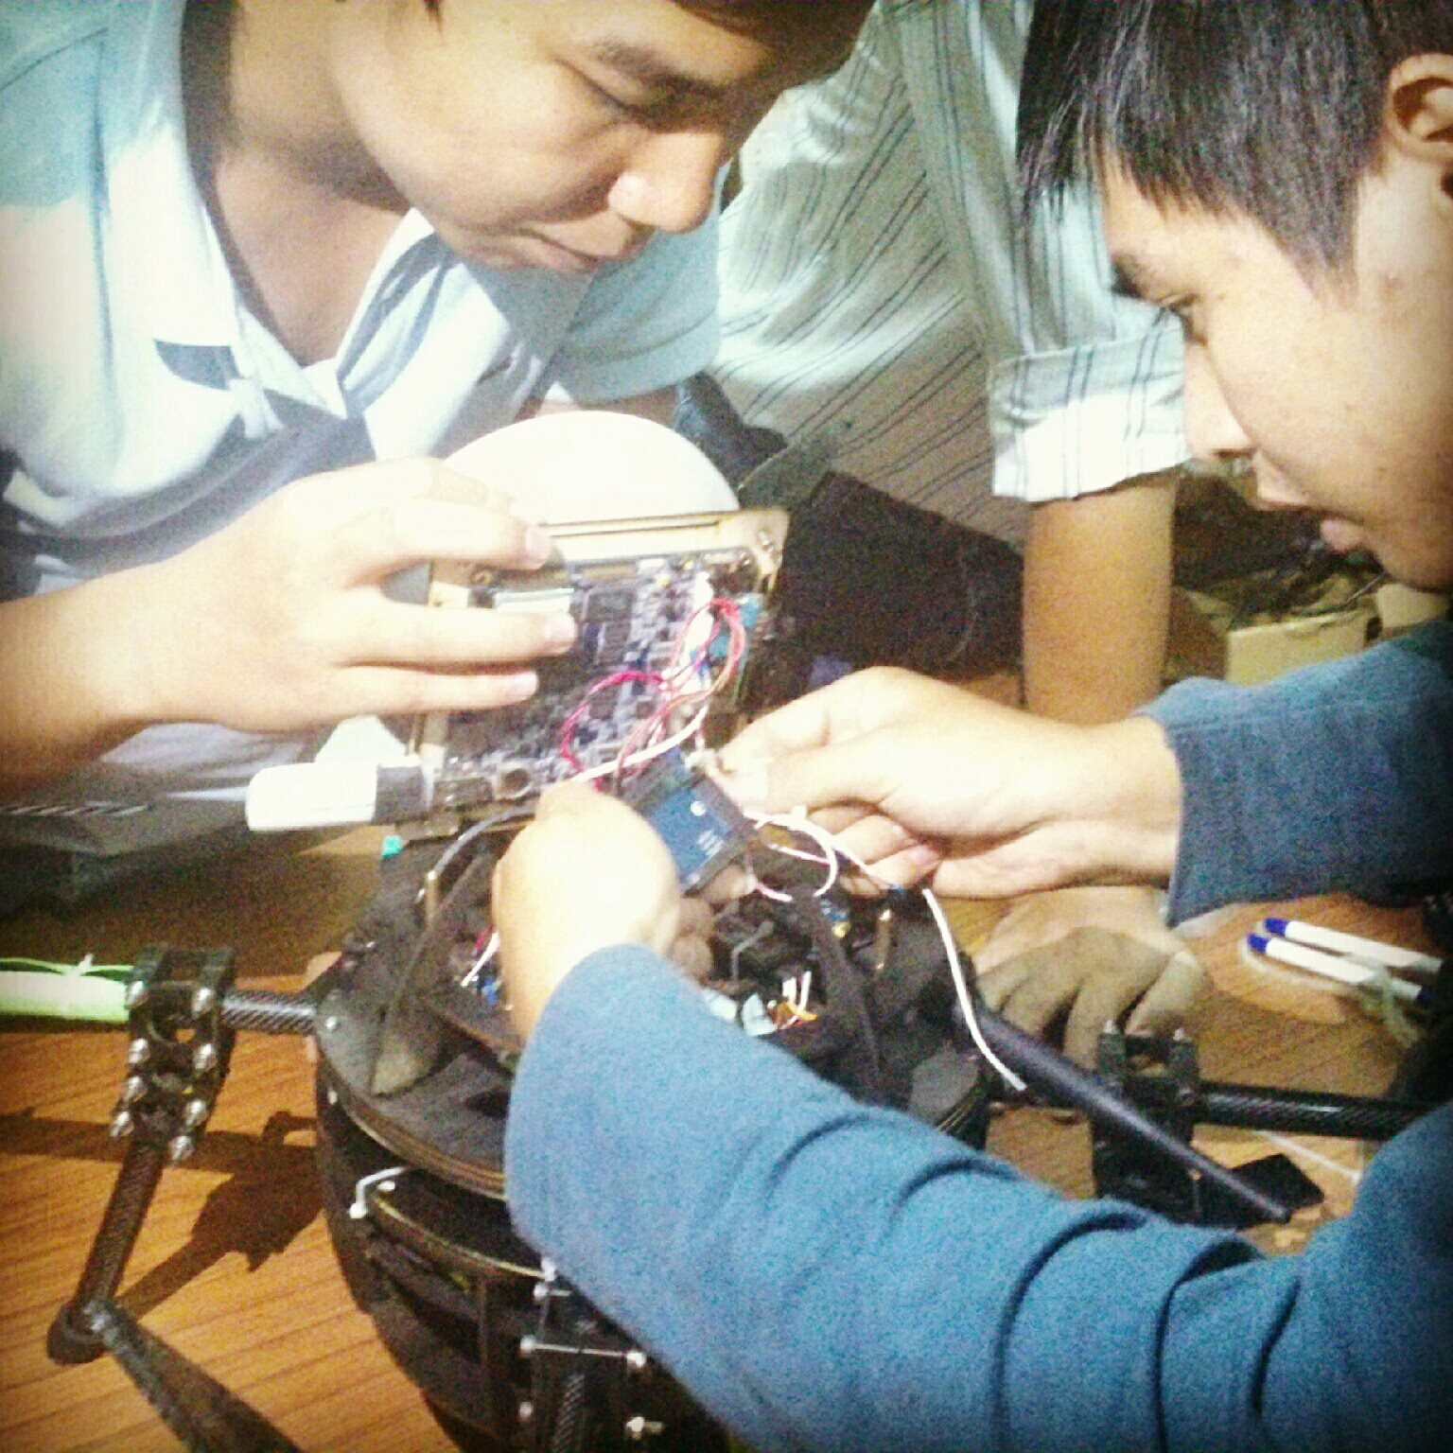
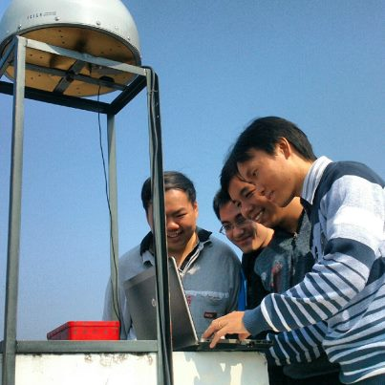
… a Summary
1 Director from Vietnam and 1 Co-Director from Europe (Politecnico di Torino – Italia)
Scientific committee with 7 international experts in the field of GNSS (Australia, Germany, Italy, Spain, and Vietnam)
4 Supporting institutions with direct involvement (Italy, Vietnam, and Spain)
15 Researchers;
9 international workshops and conferences co-organized in the last thee years;
65 international publications since 2010 (9 IEEE Transactions & other SCI journals)
12 international projects with EU-FP7, ESA, JAXA, UNSW, JRC-EC, Horizon 2020
15 national projects funded by national programs, bilateral program, ministries, cities and HUST

Slide 10
NAVIS Services
Awareness
Education and Training
Technology Transfer
Support to Public bodies
Research and Technological Development

Slide 11
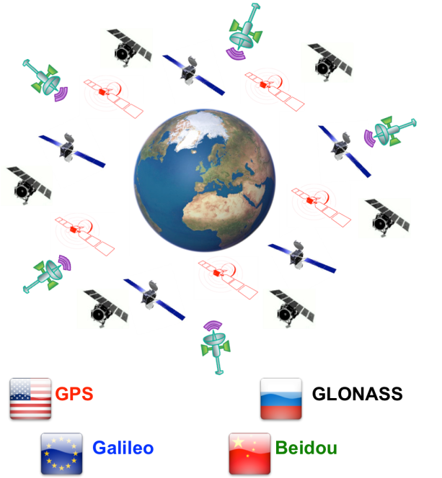
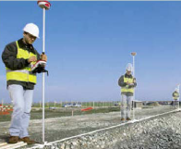


Research Topics
Multi-GNSS signal processing and receiver designs
Precise positioning technologies (cm/mm levels of accuracy): DGNSS/RTK/PPP
Positioning reliability / security:
Ionospheric scintillation monitoring
GPS anti-spoofing and anti-jamming
Intelligent Transport System (ITS) and Location-Based Services (LBS)

Slide 12
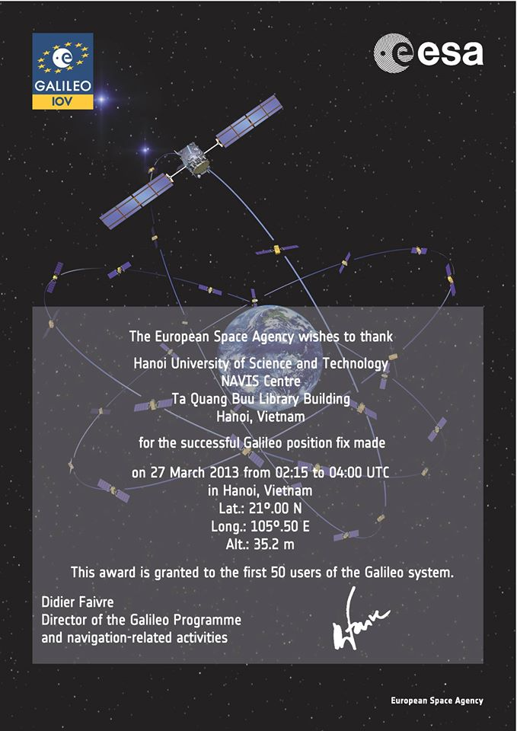
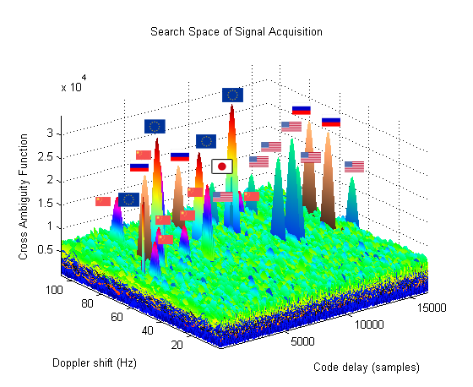
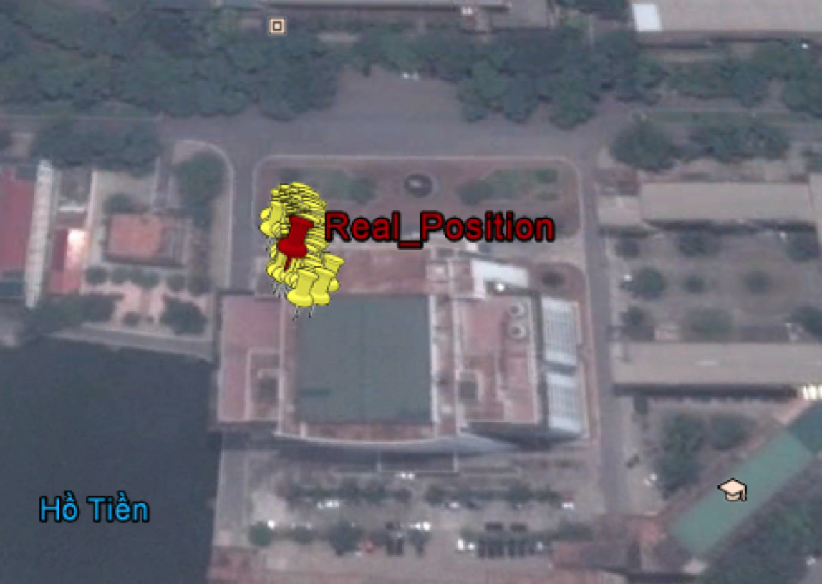
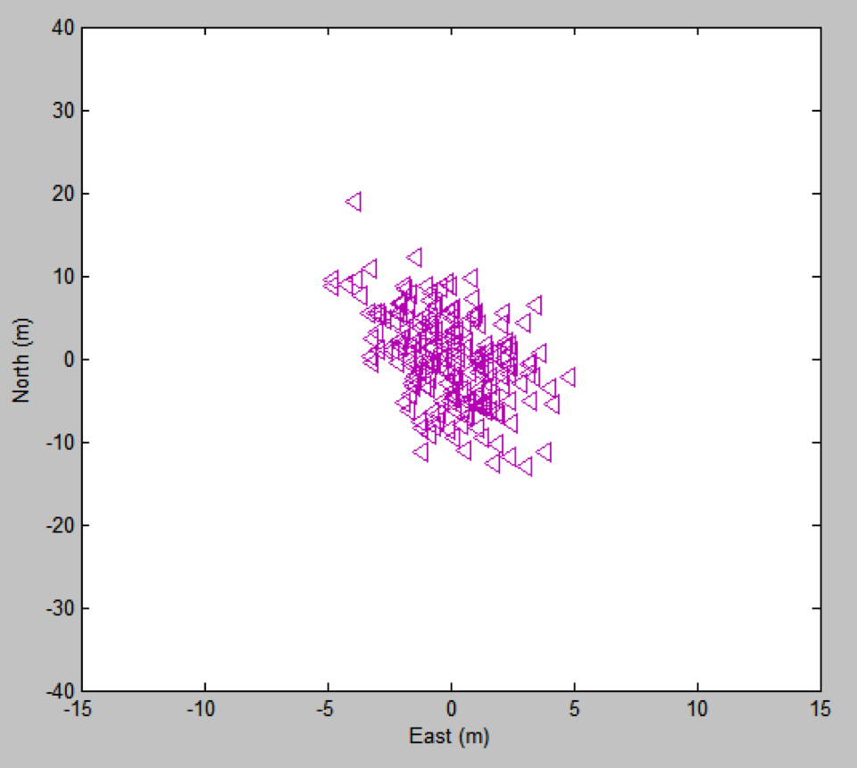
(1) NAVISOFT: Multi-GNSS Receiver
Some R&D Results
Among 50 first users of the Galileo system
GPS/GLONASS/Galileo/Beidou/QZSS multi-system solutions

Slide 13
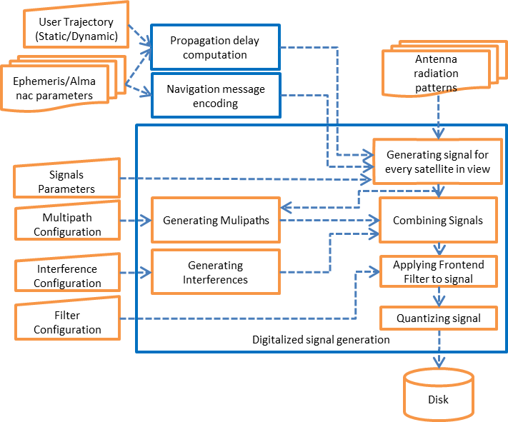
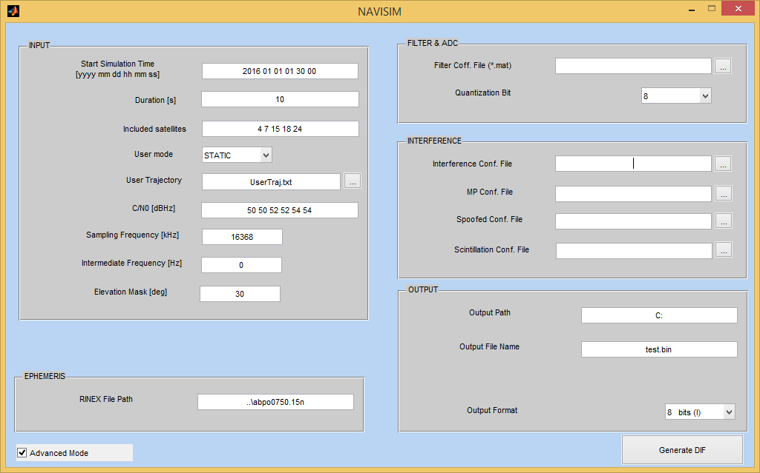
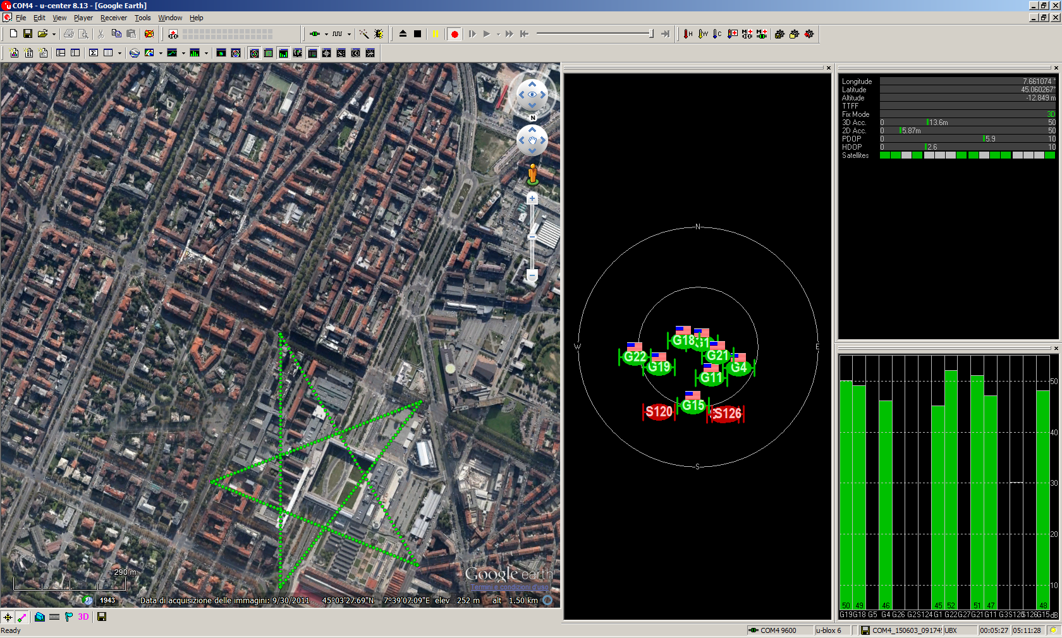
(2) NAVISIM: a GNSS software-based signal simulator
Low cost and flexible tool for receiver evalutation in different scenarios, as well as signal processing algorithm testing
Some R&D Results

Slide 14
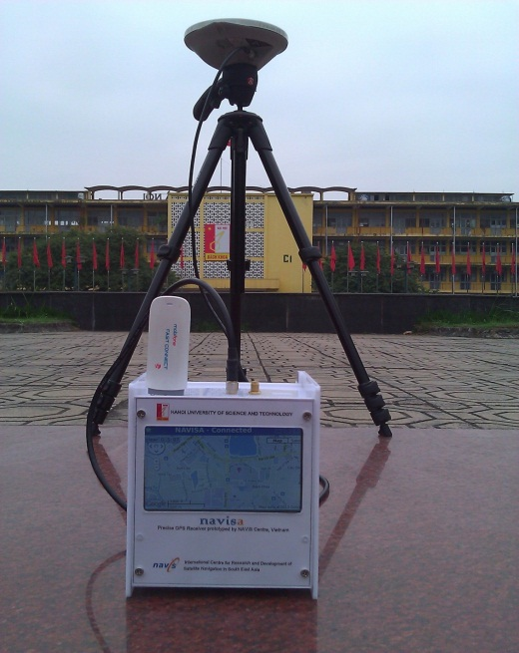
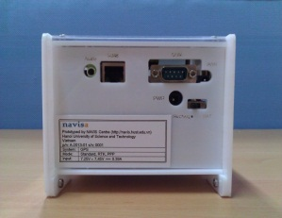
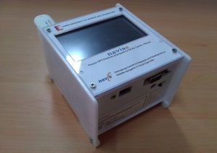
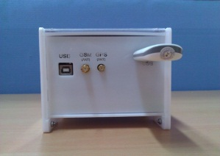
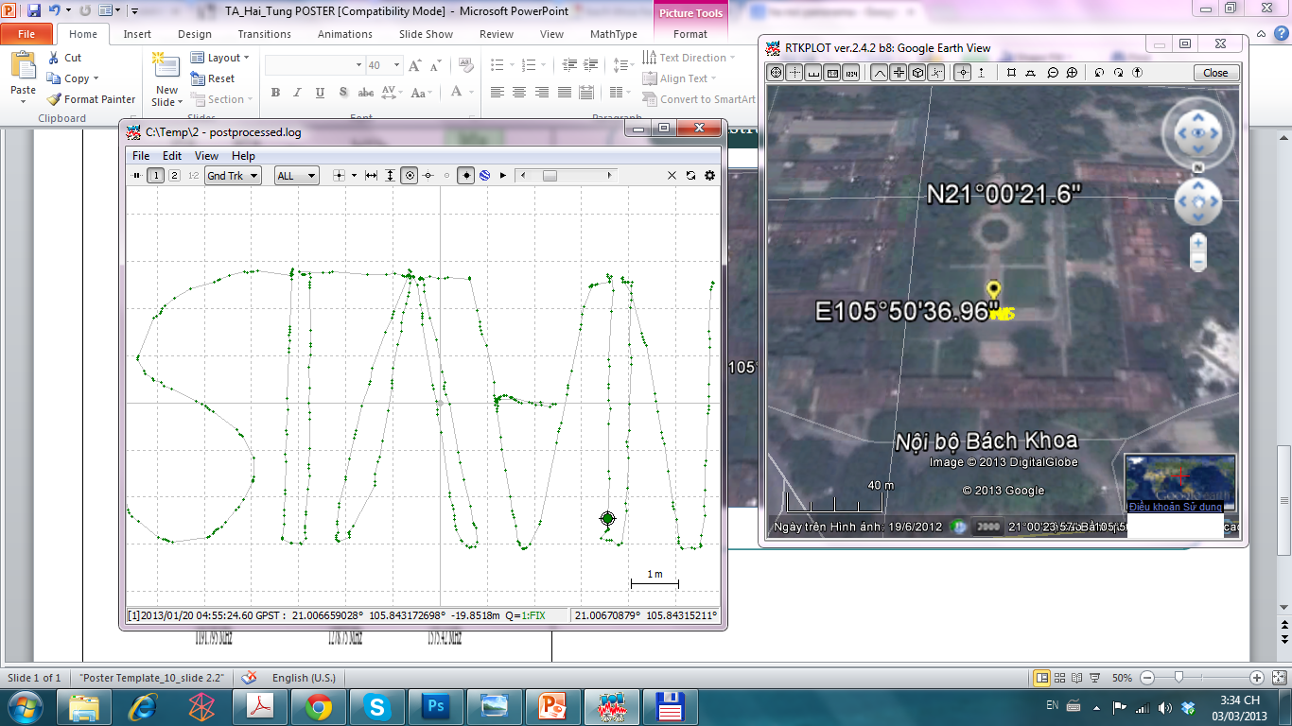
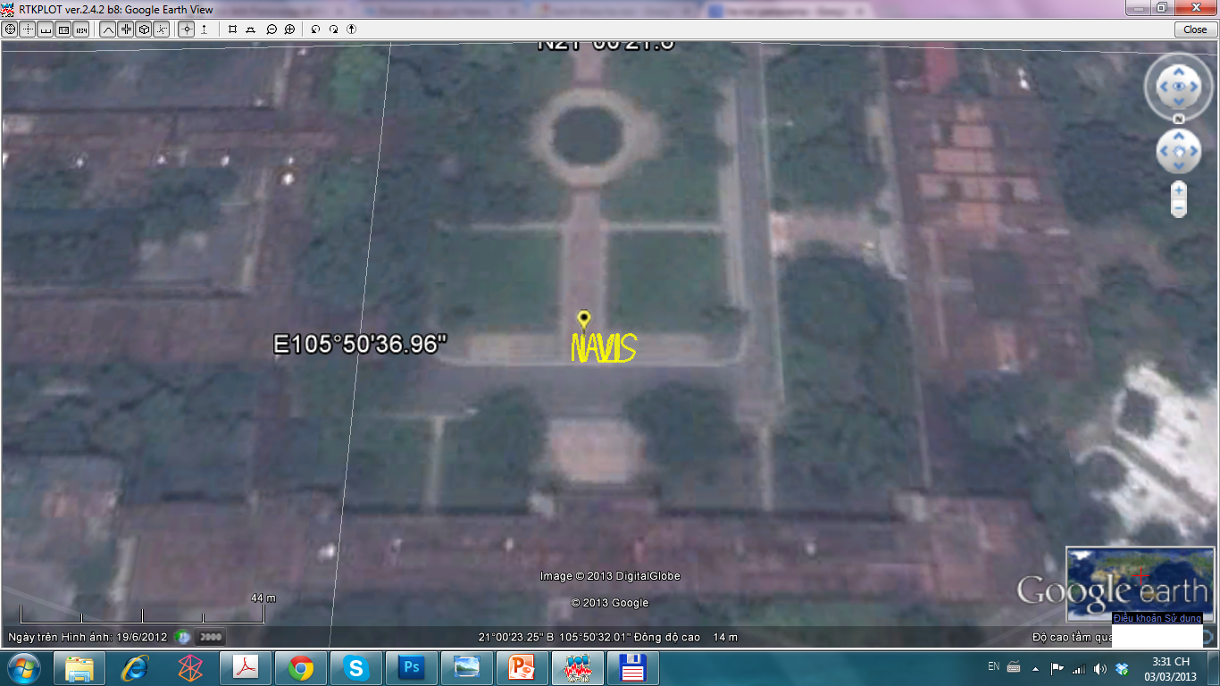
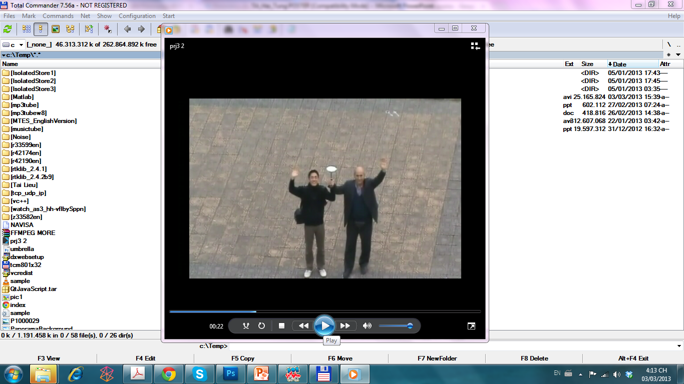
(3) NAVISA: Precise GNSS RTK/PPP Receiver
A Precise GNSS Receiver: cm/mm levels of accuracy
Positioning
Supported systems: GPS / QZSS
Output format: NMEA, LLH
Output rate: 10 Hz
Mode: RTK or PPP
Data storage
In memory storage 2 GB
Support external SD Card
Display
3.5” touch screen
Up to 1024x768 resolution
I/O Ports
Ethernet
USB
COM (RS232)
Operating
Charging Input: 7.25-7.45 VDC @ 0.4A
Some R&D Results

Slide 15
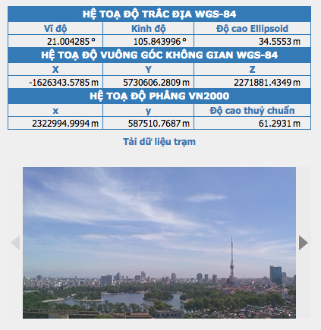
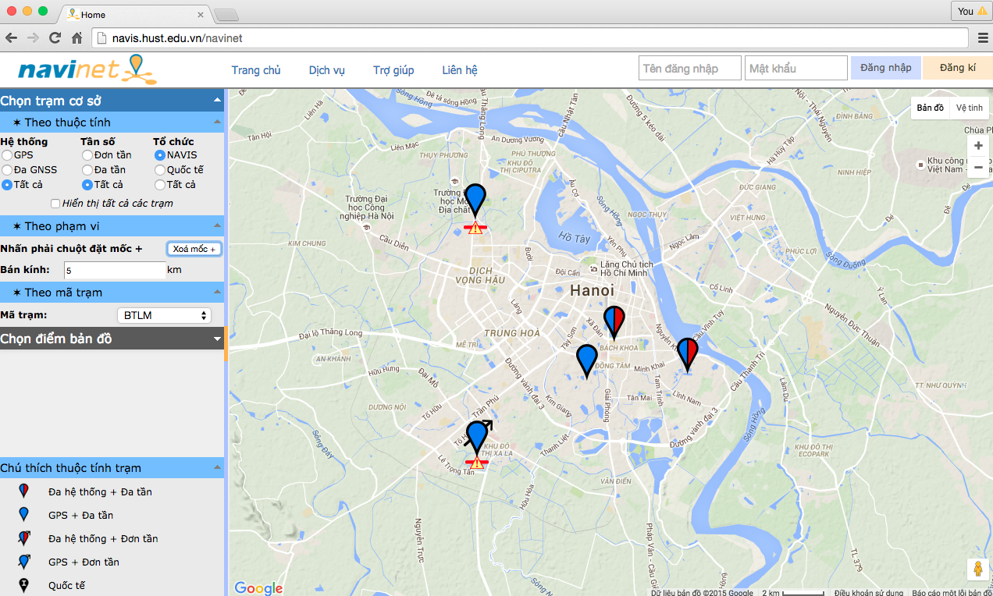
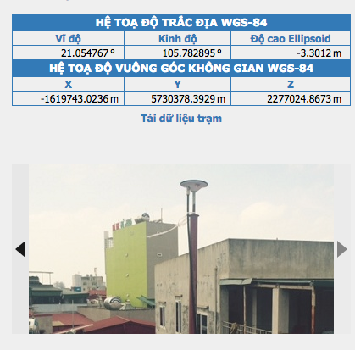
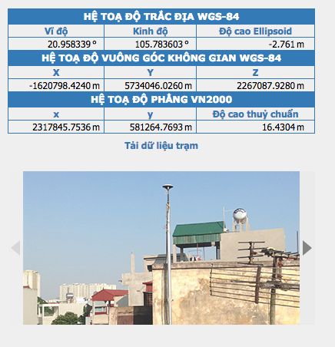
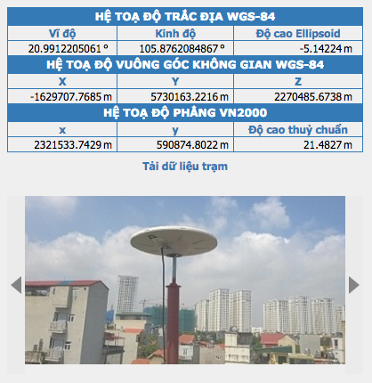
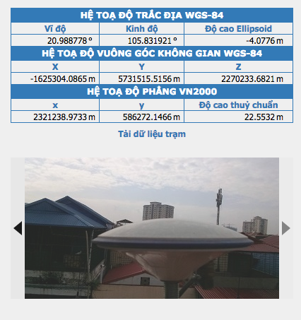
(4) NAVINET: Prototype for Network RTK in Hanoi
Based on NAVISA: a small RTK network was set up, which provide:
(1) RTCM stream via NTRIP Caster; (2) RINEX files for post processing;
(3) IGS products; (4) Post-Processing Postioning for registered users
12 km
8.48 km
10.7 km
3.65 km
2.13 km
8.1 km
10.5 km

Slide 16
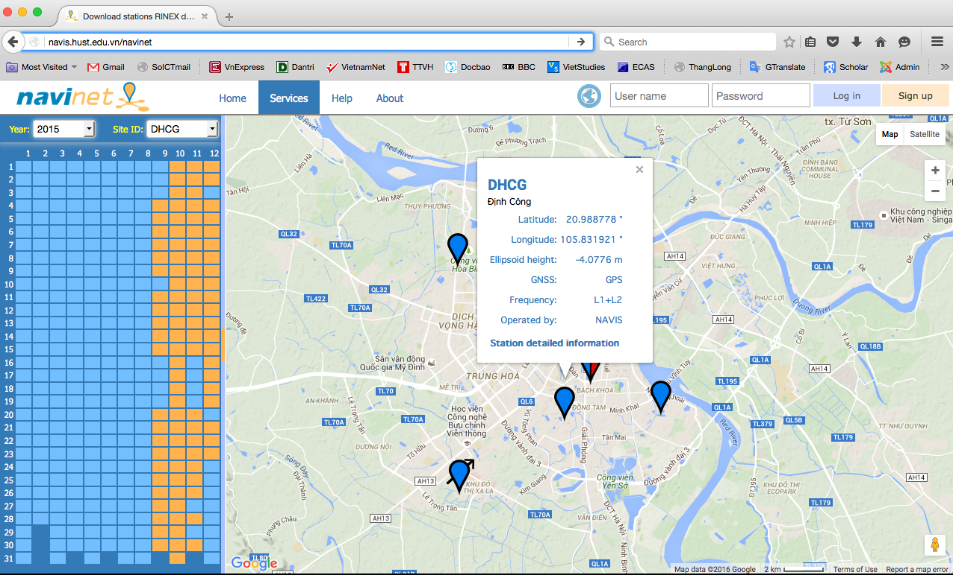
RINEX files of all the stations are uploaded to the data centre deployed on Microsoft Cloud service – Azure; Available at http://navis.hust.edu.vn/navinet (Vietnamese/English/Italian)
Good source for low latitude ionospheric studies!!!

Slide 17
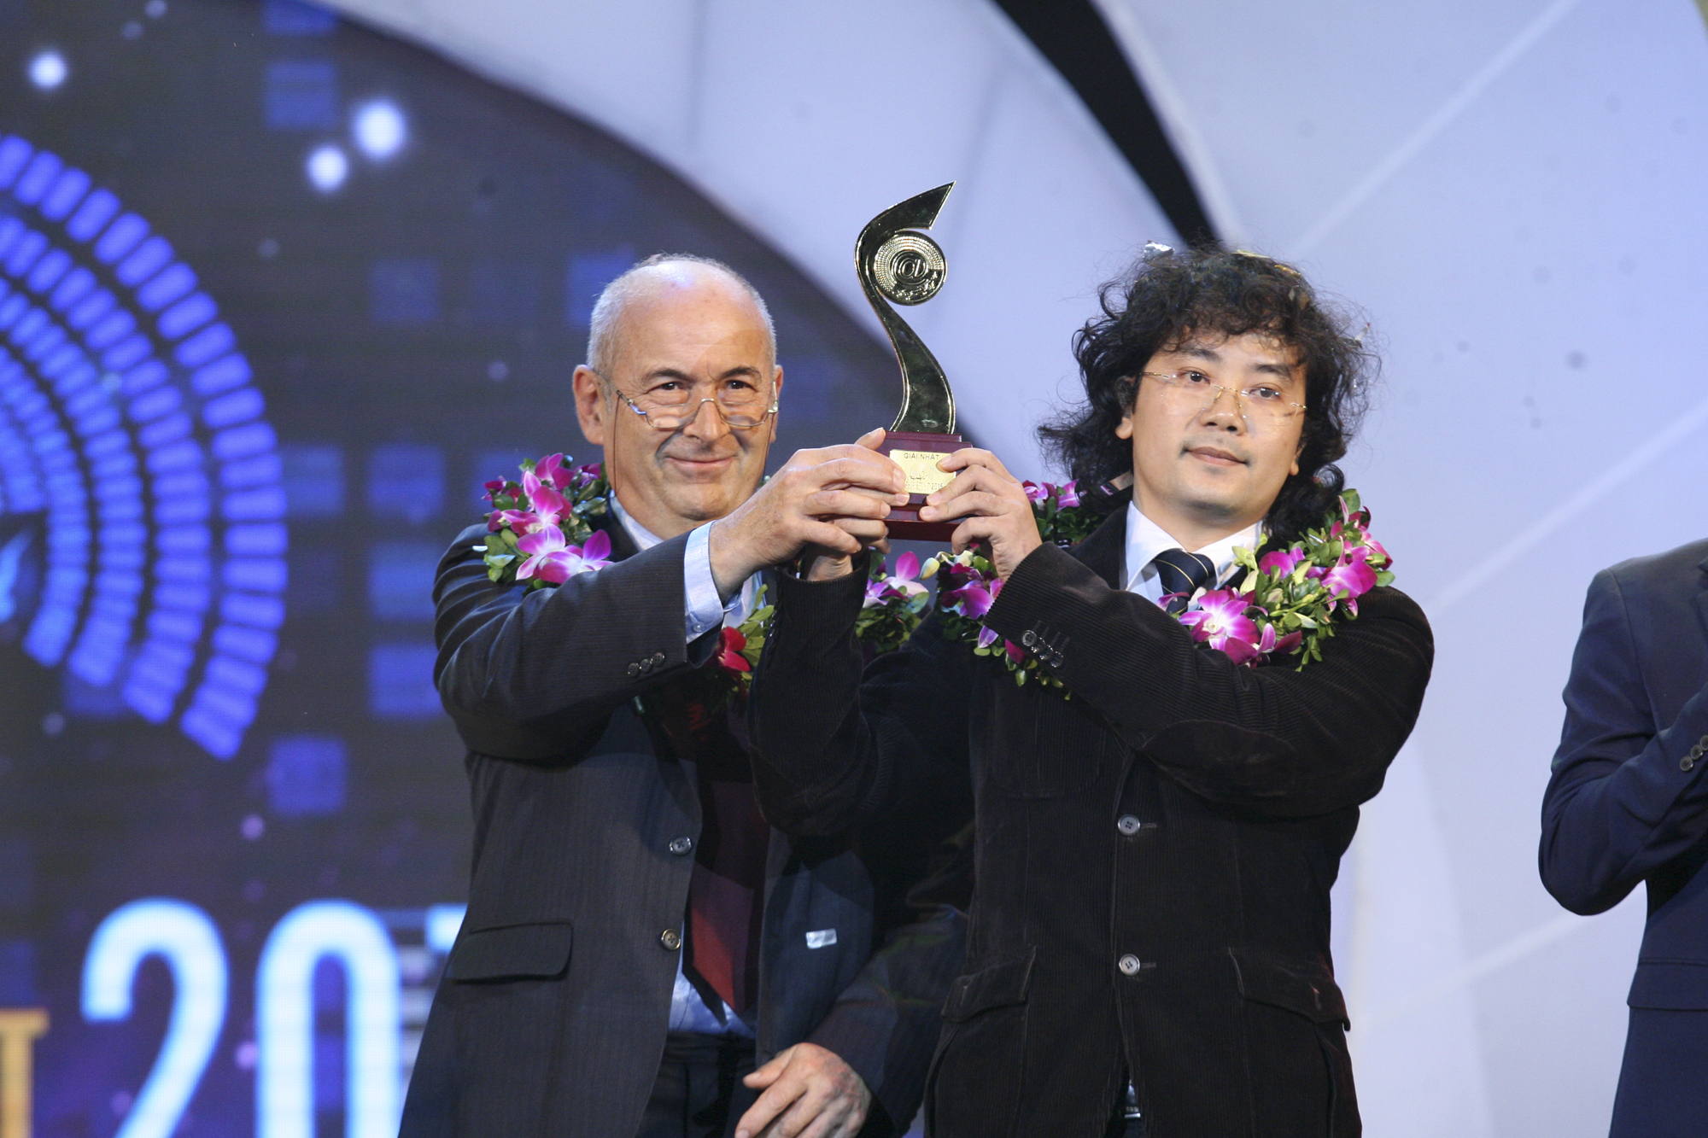
1st Prize of the biggest Vietnam IT product competition in 2015!

Slide 18
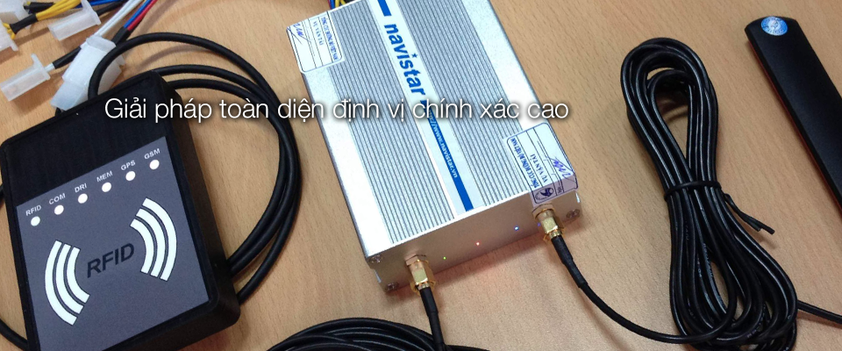
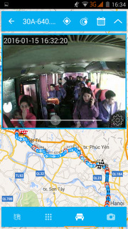
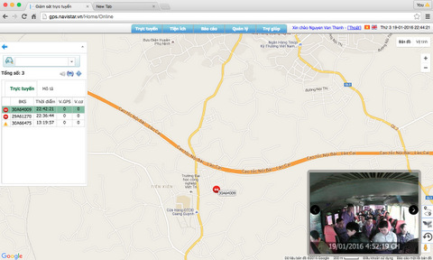
(5) NAVISTAR: Vehicle Monitoring System
The first 20 organizations got the license from the Ministry of Transport for providing this service (the 2014 National Standard QCVN 31: 2014)
Since November 2015: ~1000 users using the service.
Some R&D Results
Black-box installed on vehicles
Data centre / Server program
Smartphone app

Slide 19
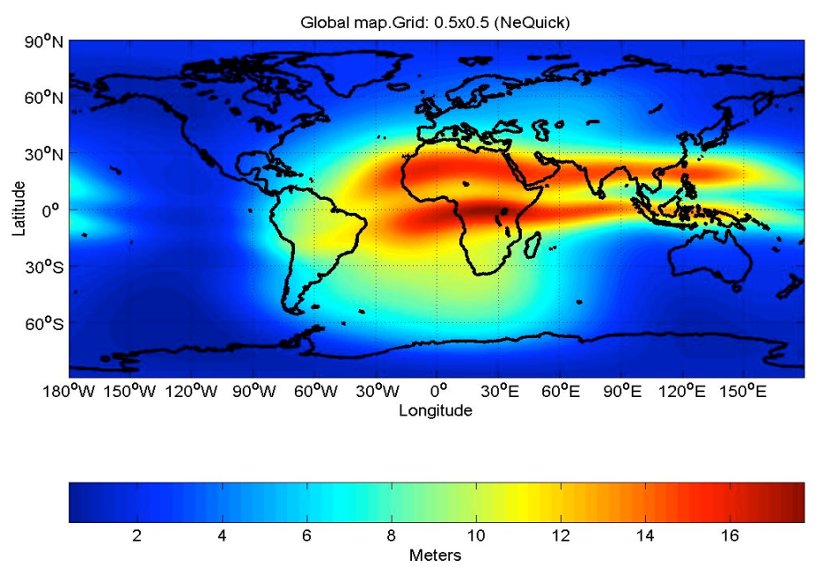
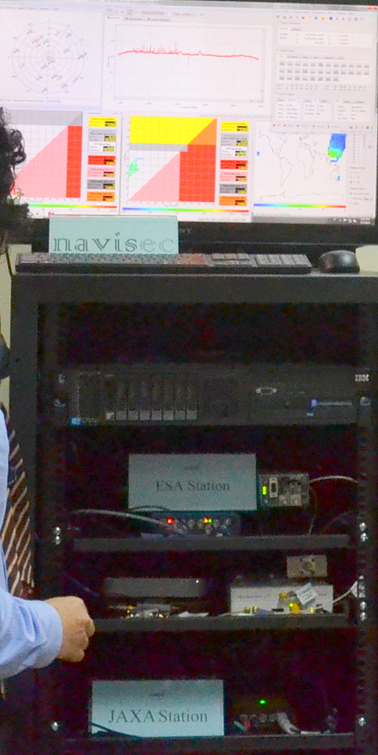

(6) Collaborations on Signal and Ionopheric Monitoring
JAXA (Japan Aerospace Exploration Agency) signal monitoring station since 2012
ESA (European Space Agency) station since 2013
JRC-IPSC (The Institute for the Protection and Security of the Citizen of the European Commission Joint Research Centre) for monitoring ionosphere scintillation events.
INGV (Istituto Nazionale di Geofisica e Vulcanologia) and ISMB and Polito on GINESTRA / ERICA projects funded by ESA

Slide 20
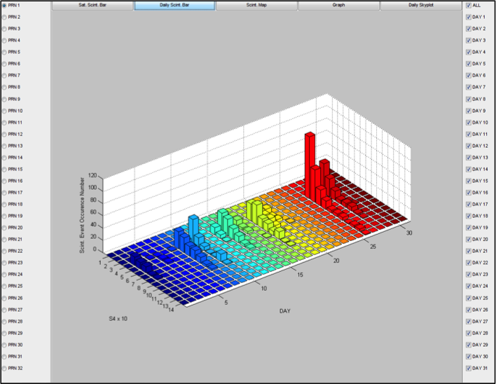
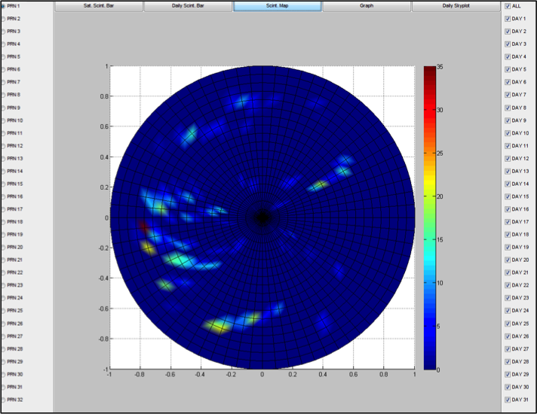
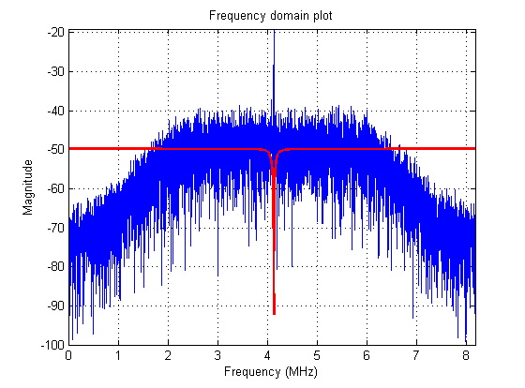
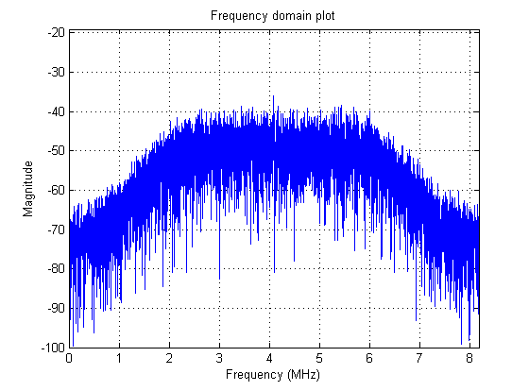
Ionospheric scintillation monitoring
Reduce the effect of interference:
Filter out the interference

Slide 21
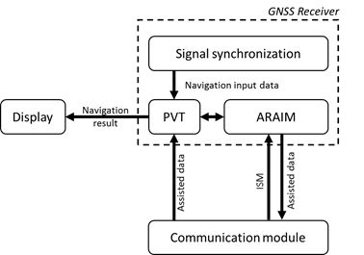
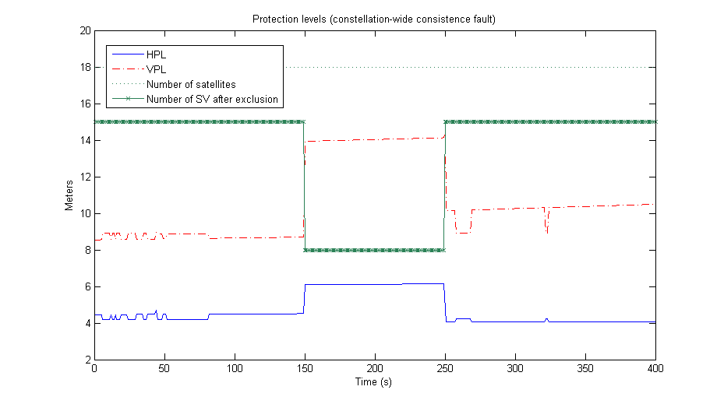
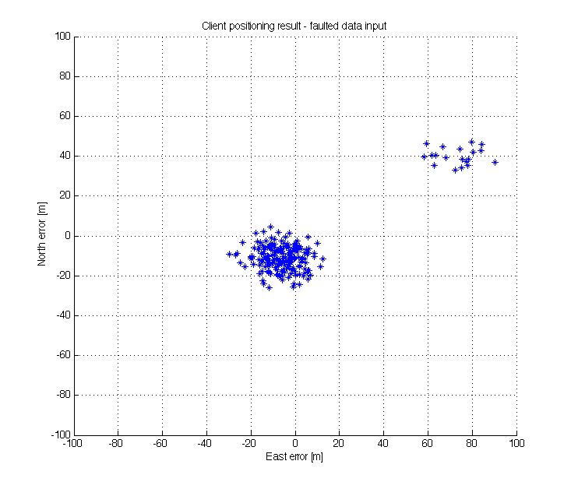
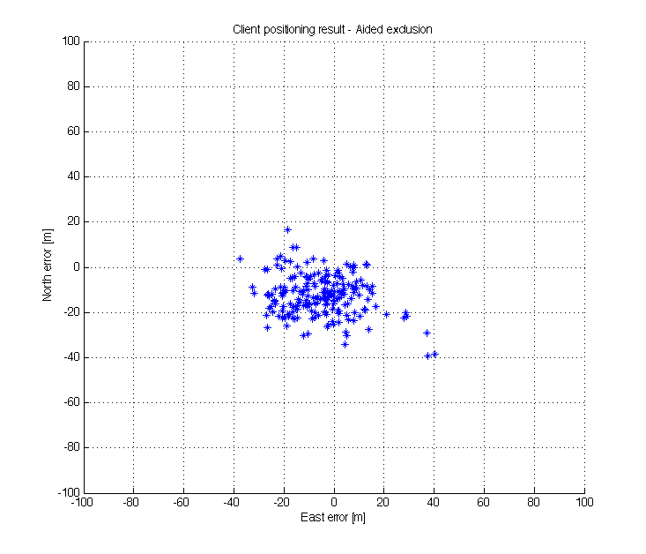
Anti-spoofing and intergrity research
Faulty position fixes

Slide 22
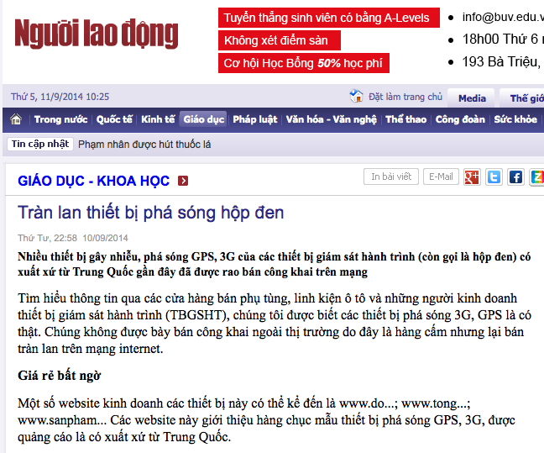
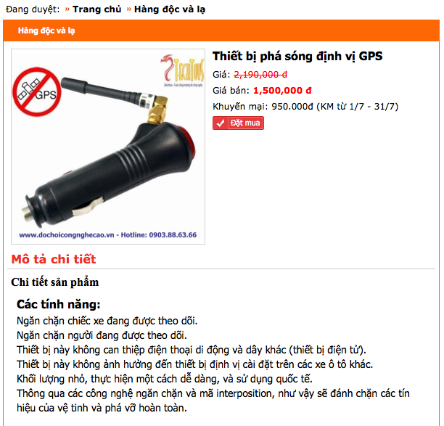
Jamming problems: mobile jammer installed on vehicles

Slide 23
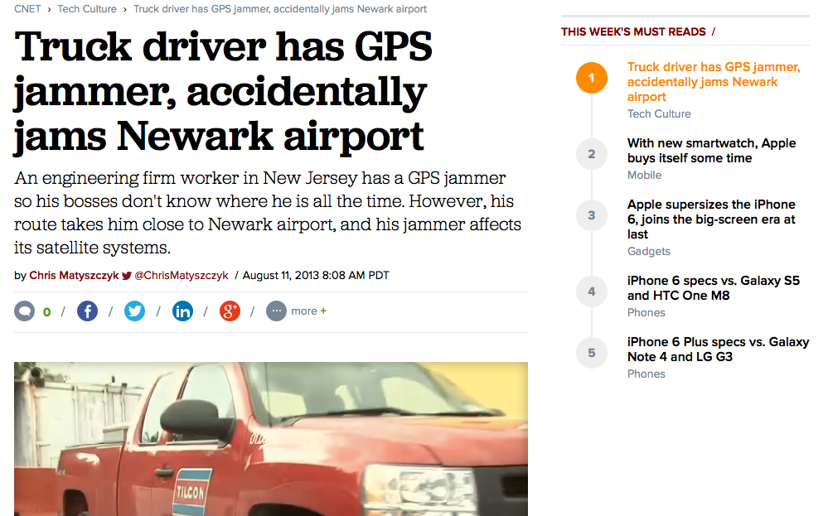


Slide 24


Spoofing problems

Slide 25





Slide 26
International Cooperations
Cooperations with Europe partners:
Universities: Polito, UPC, UFC…
Organization/Institution: JRC, ESA, ISMB, INGV…
Cooperation with Japan:
JAXA, universities…
Cooperation with Australia:
University of New South Wales (UNSW)…
Cooperation with ASEAN Member States:
via bi-lateral, multi-lateral projects, and regional orgnizations such as SCOSA, MGA…
Member of Multi-GNSS Asia (MGA)

Slide 27


Organize international workshops, conferences
The 4th Asian-Oceania Regional Workshop on GNSS
8-10 December 2012, Kuala Lumpur, Malaysia

Slide 28



The 5th Asian-Oceania Regional Workshop on GNSS
1-3 December 2013, Hanoi, Vietnam
Summer School on: “Multi-GNSS Environment for Sustainable Development”, 9-13 September 2013, Hoi An City, Vietnam

Slide 29



The 6th Asian-Oceania Regional Workshop on GNSS
9-11 October 2014, Phuket, Thailand

Slide 30



Slide 31


Recognition from international organizations

Slide 32


International Committee on GNSS, United Nations

Slide 33


Multi GNSS Asia: tổ chức về GNSS lớn nhất Châu Á và Châu Đại Dương với 48 thành viên là trường đại học, viện nghiên cứu, công ty trong lĩnh vực GNSS.
Ban Điều hành:
Prof. Chriz Rizos, University of New South Wales, Australia
Prof. Teruyaki Kato, University of Tokyo, Japan
Mr. David Turner, Department of State, USA
Prof. Akio Yasuda, Tokyo University of Marine Science and Technology
Dr. Noordin Ahmad, Director General of ANGKASA, Malaysia
Prof. Sorawit Narupiti, Chulalongkorn University, Thailand
Prof. Noburo Nogochi, Hokkaido University, Japan
Prof. Naohiko Kohtake, Keio University, Japan
Prof. Ta Hai Tung, Hanoi University of Science and Technology, Vietnam
Mr. Rainer Horn, GNSS.Asia Project, Germany

Slide 34
Conclusions
South-East Asia (including Vietnam) is covered by the largest number of systems (GNSSes + RNSSes); and
The difficult ionosphere of a low latitude region
➔ interesting region for GNSS research, development, and applications; as well as a good environment for testing the performance of any satnav products.
NAVIS Centre at HUST has strong expertise, good national/international relationships, increasing reputation in the field of GNSS; as well as good familiarity with European working environment.
➔ NAVIS is aiming at being a hub for GNSS R&D and training as well as promoting European GNSS solutions for users in the region.
We’re open for any ideas on cooperations in the field of GNSS

Slide 35




Thank you very much for your attention!
Email: navis@hust.edu.vn
NAVIS Centre at HUST
NAVIS
Centre
http://navis.hust.edu.vn

